Slide 1
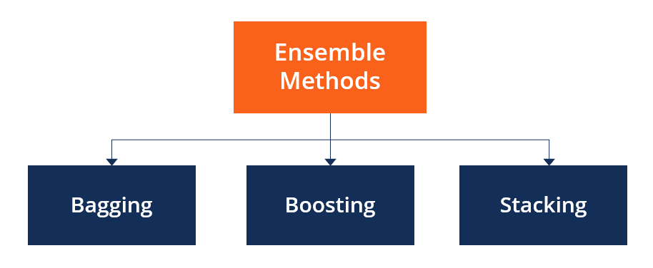
C4 – Ensemble learning
my humble ML course

Slide 2
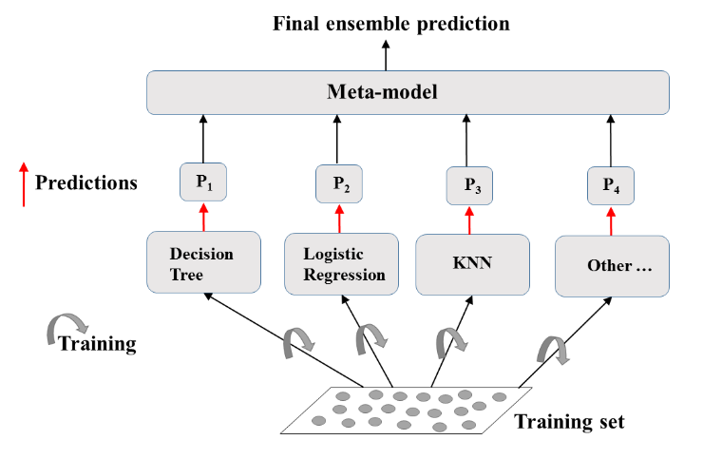
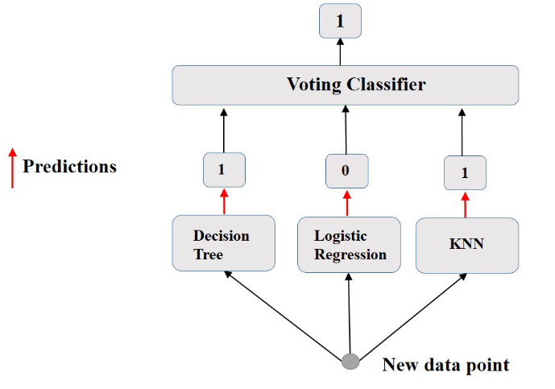

my humble ML course
Ensemble Learning: visual generalization
.
Notes:
tree based models in Google

Slide 3
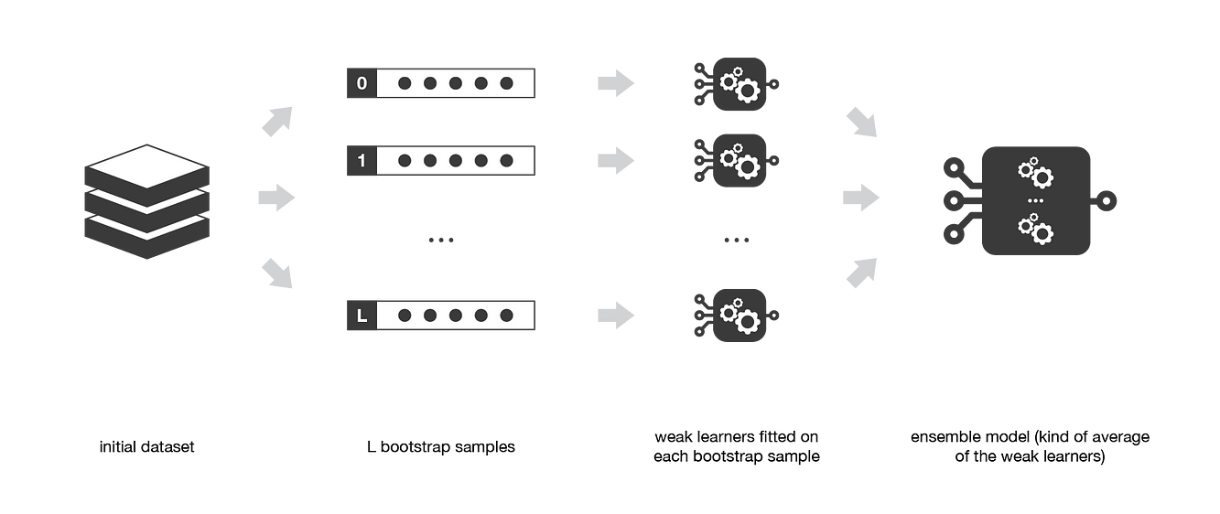
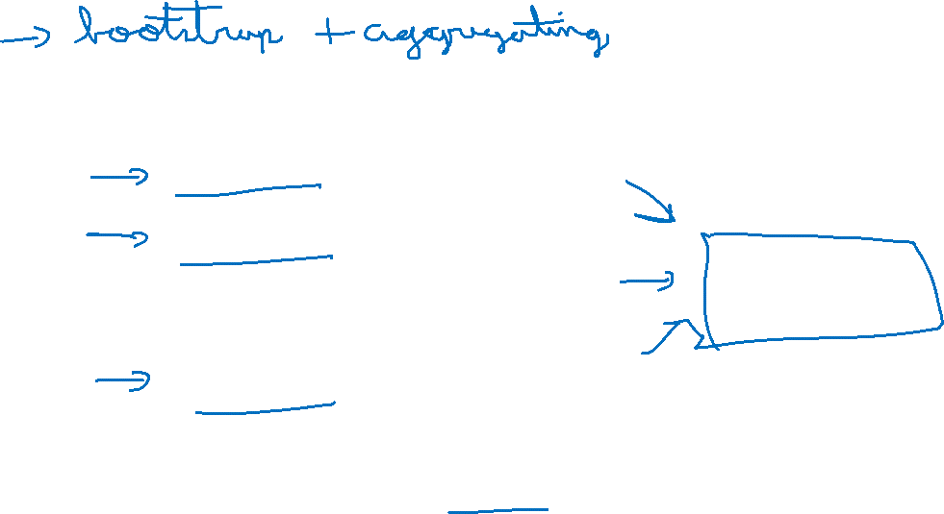
my humble ML course
Bagging
Notes:
tree based models in Google

Slide 4
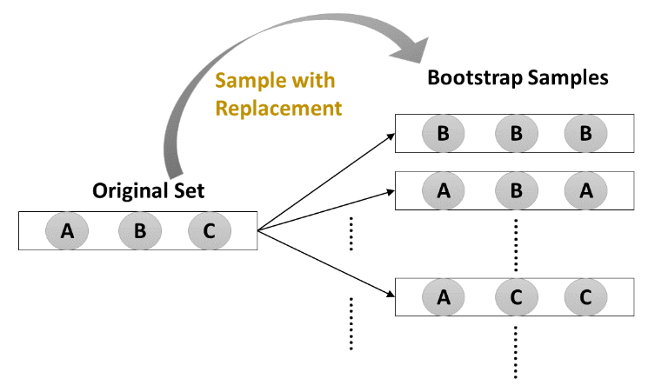

my humble ML course
Bagging
One algorithm
$≠$ subsets of training set
Reduces variance of individual models in the ensemble
Notes:
tree based models in Google

Slide 5
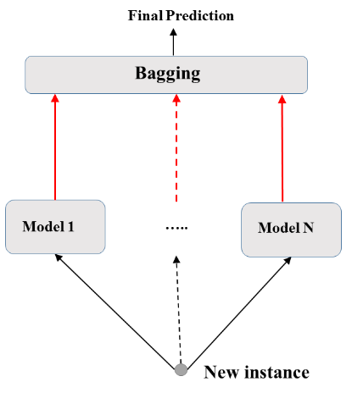
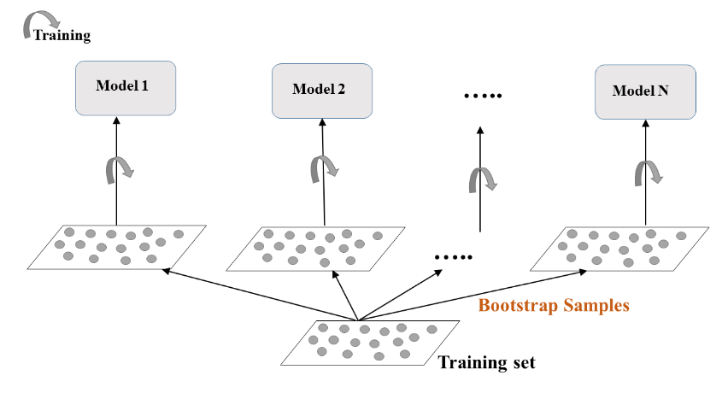
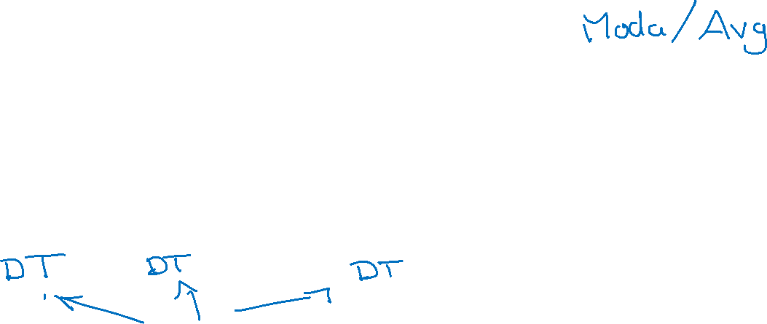
my humble ML course
Bagging
Notes:
tree based models in Google

Slide 6
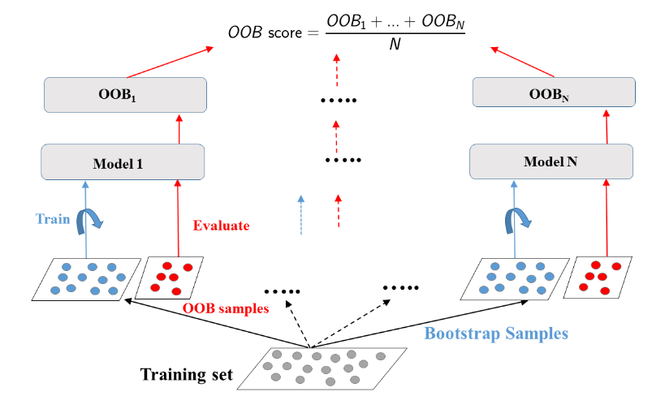
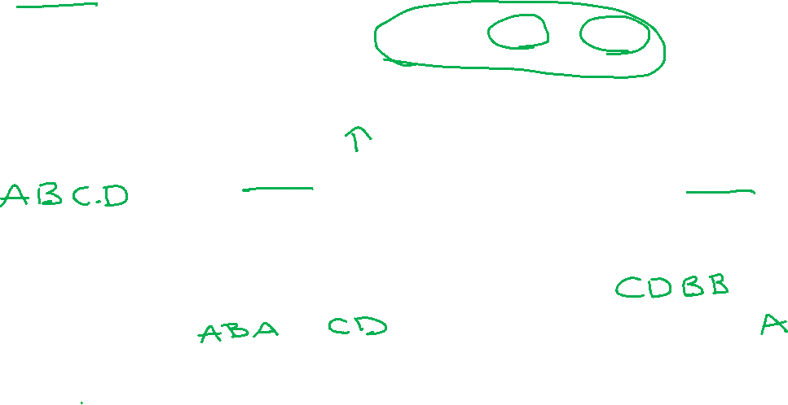
my humble ML course
OOB (Out of Bagging Evaluation)
Notes:
tree based models in Google

Slide 7
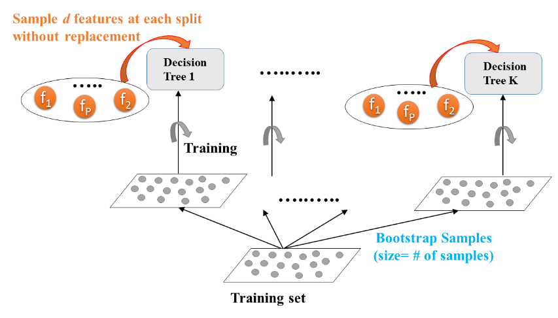

my humble ML course
Random Forest
Notes:
tree based models in Google

Slide 8
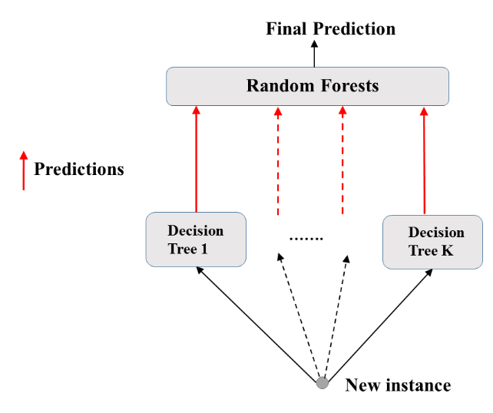
my humble ML course
Random Forests
.
Notes:
tree based models in Google

Slide 9
Boosting
my humble ML course

Slide 10
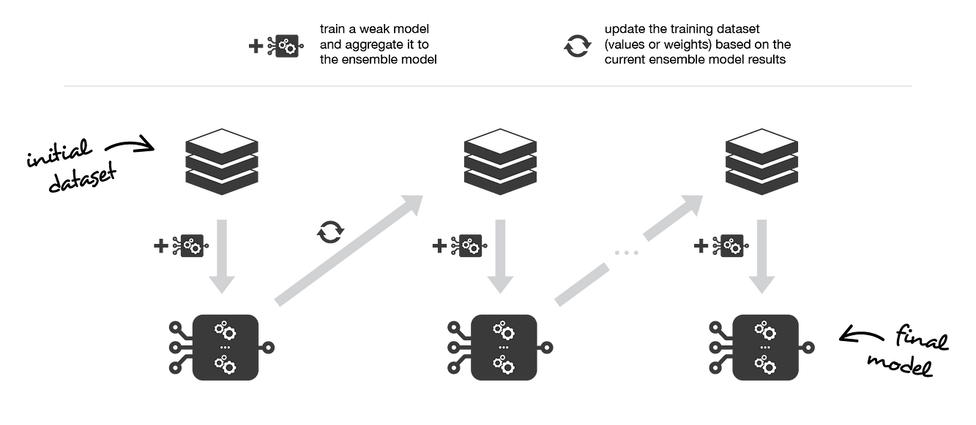

my humble ML course
Boosting
Notes:
tree based models in Google

Slide 11
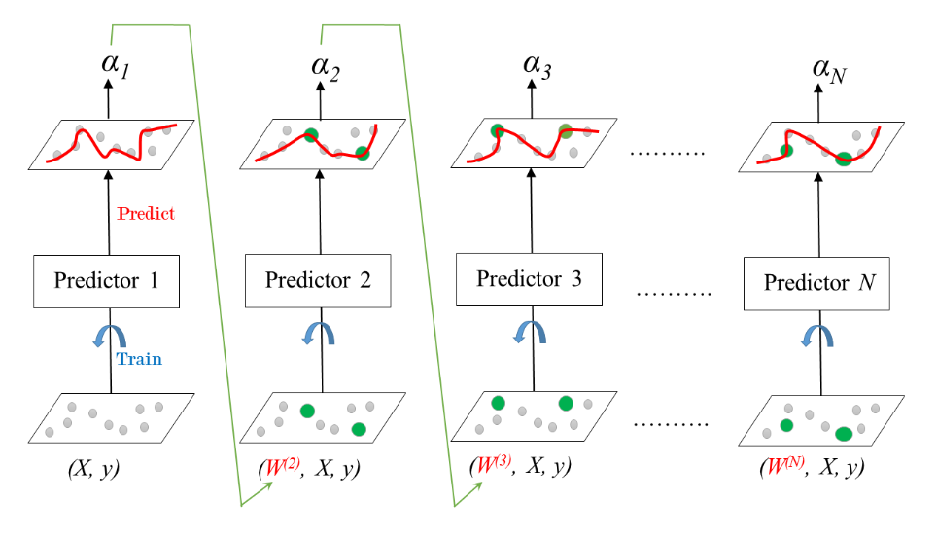

my humble ML course
AdaBoost
.
Notes:
tree based models in Google

Slide 12
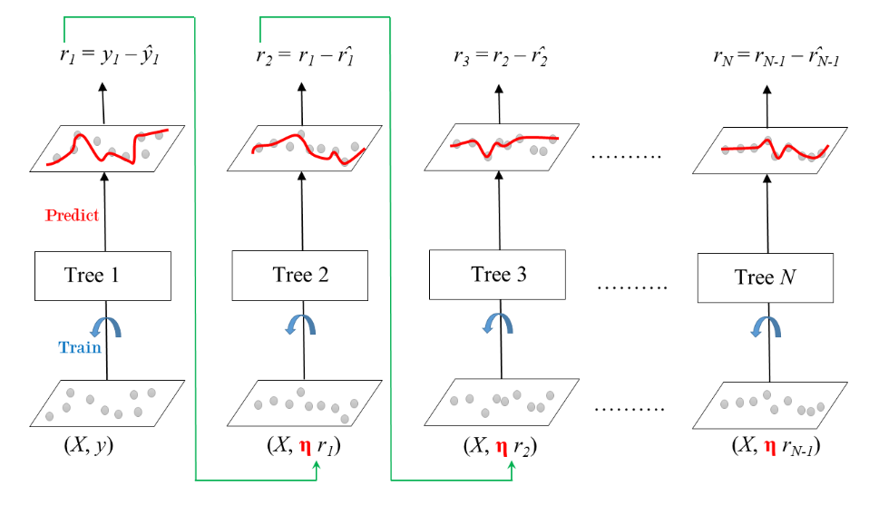

my humble ML course
GBM (Gradient Boosting Machine)
.
Notes:
tree based models in Google

Slide 13
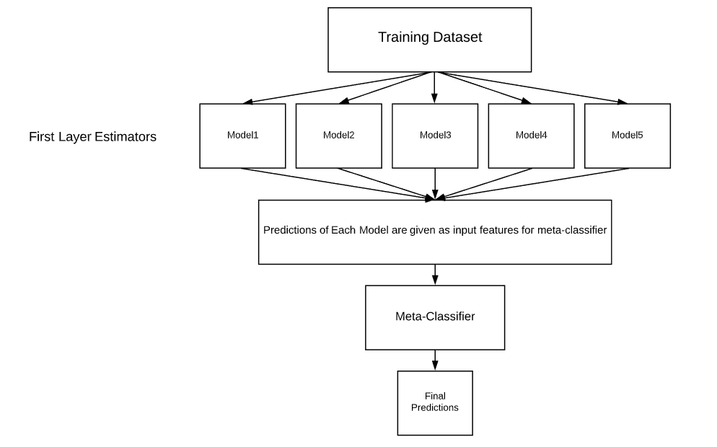
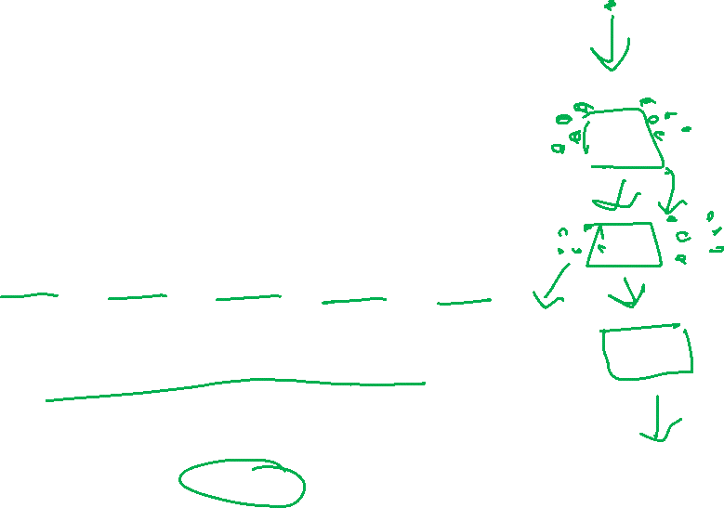
Stacking
my humble ML course

Slide 14
my humble ML course
Bibliography
https://app.datacamp.com/learn/courses/machine-learning-with-tree-based-models-in-python
https://towardsdatascience.com/ensemble-methods-bagging-boosting-and-stacking-c9214a10a205
https://www.geeksforgeeks.org/stacking-in-machine-learning/
Notes:
https://miro.com/app/board/uXjVMZythnw=/

